Slide 1
Fasteners

Slide 2
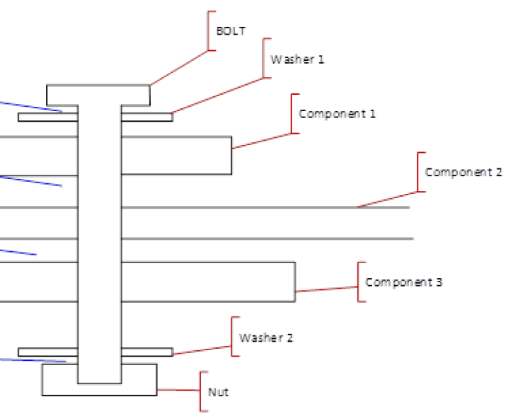
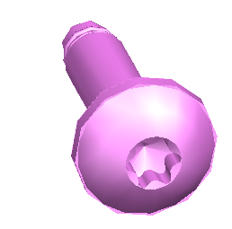
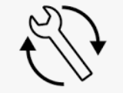

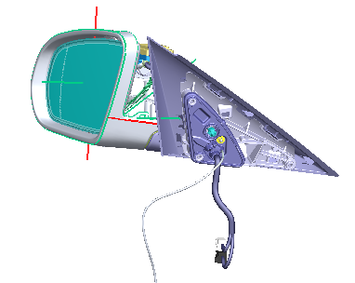
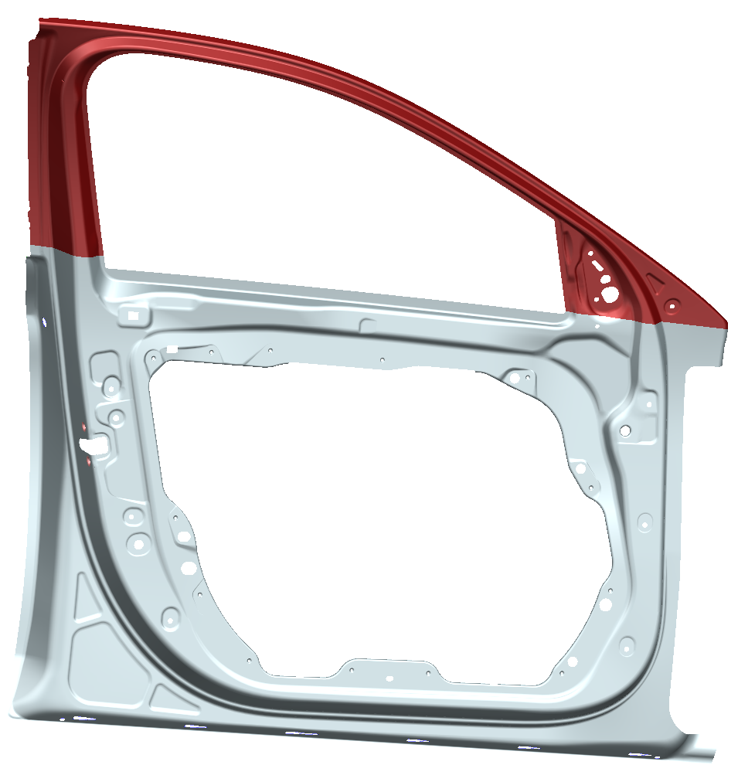
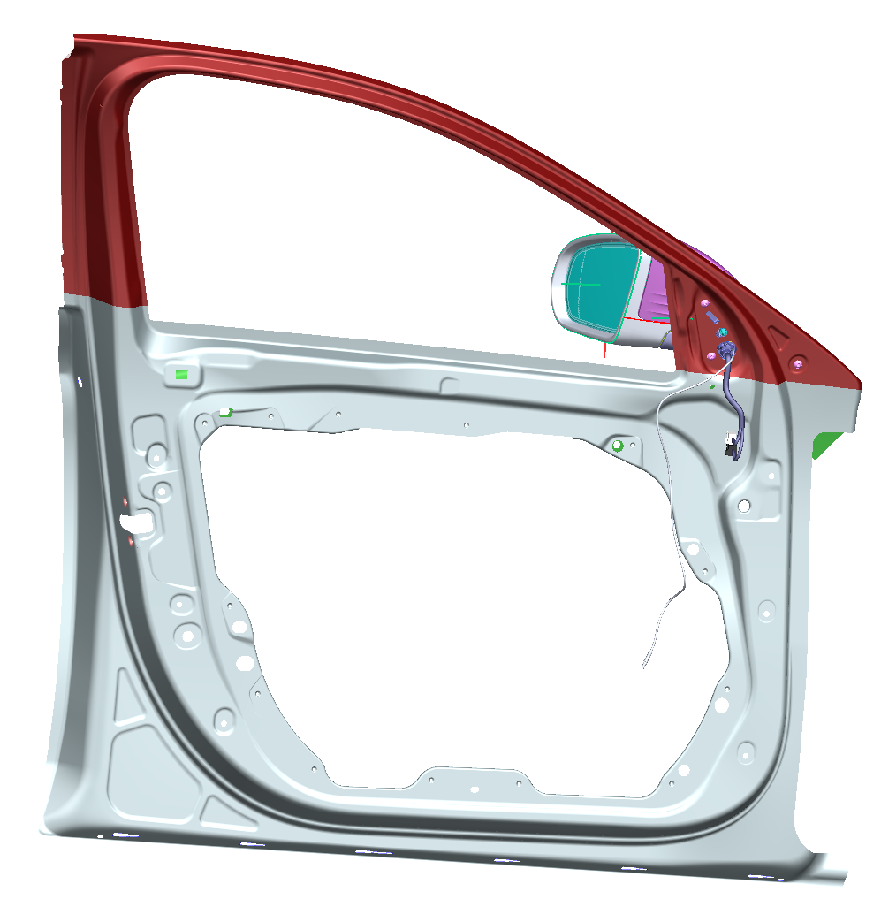
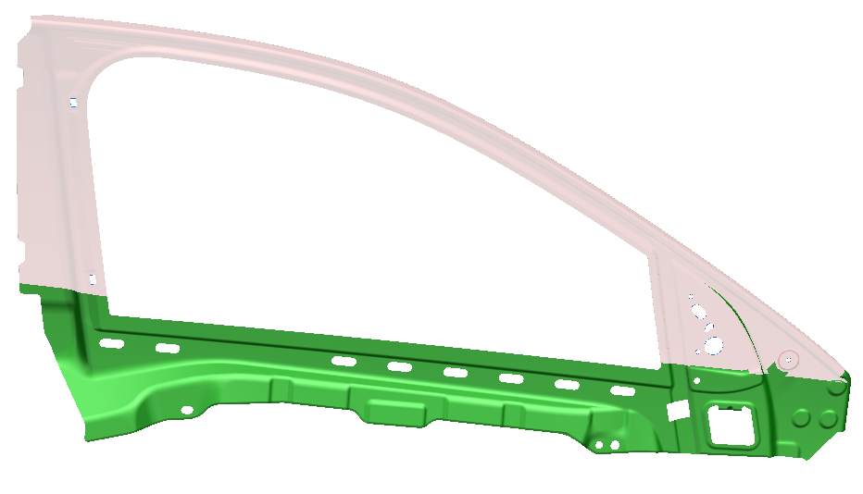
PDM-IF Scope
Fasteners
Mating bundle object, that holds/structures all the information about:
Type(s) of mating (screwing, welding, riveting, clips, gluing, …)
Which parts are mated together
Which fasteners (defined by parameters
+ defined by (derived) parts) are involved
In which order (stacking)
Direction of the fasteners and (derived) 3D positioning
Attach the Mating bundle object to the product structure (typically at the deepest assembly node that contains all mated parts).
Fasteners may be mapped as single parts or beyond a fastener-assy (for example screw+washer+nut)?
Mating attributes, for example tightening torque
In case of 150% BoM: configuration of the involved fasteners, of their 3D positioning and of the attributes
Having a stable Id of the Mating object in case of geometrical changes
Used in the same way for all types of mating (same methods and functions, with different parameters)
In scope of CAx-IF: geometric elements (like contact faces)

Slide 3
PDM-IF Scope
Modern PLM Features regarding Fasteners
Propose concrete fastener parts out of the Fastener parametric definition, the thickness of the linked parts and the material constraints
Compute (from material constraints) their number and positioning (from the wished orientation and for example equidistant)
Parametric definition of the holes the linked parts (no physical design of the holes)
=> for an automated design, supporting changes in the product design with less effort

Slide 4
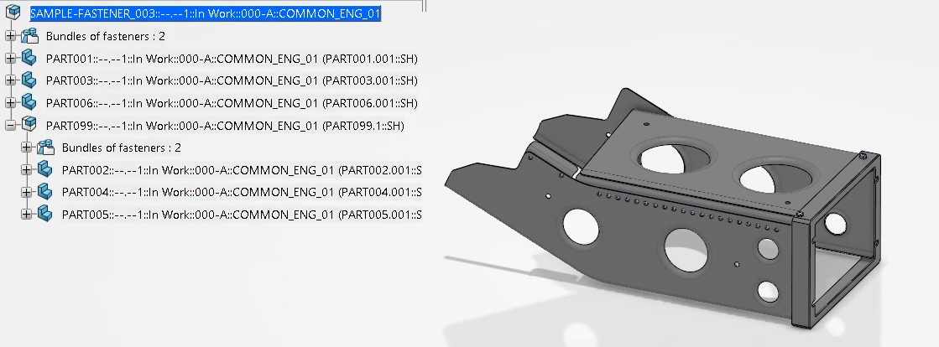
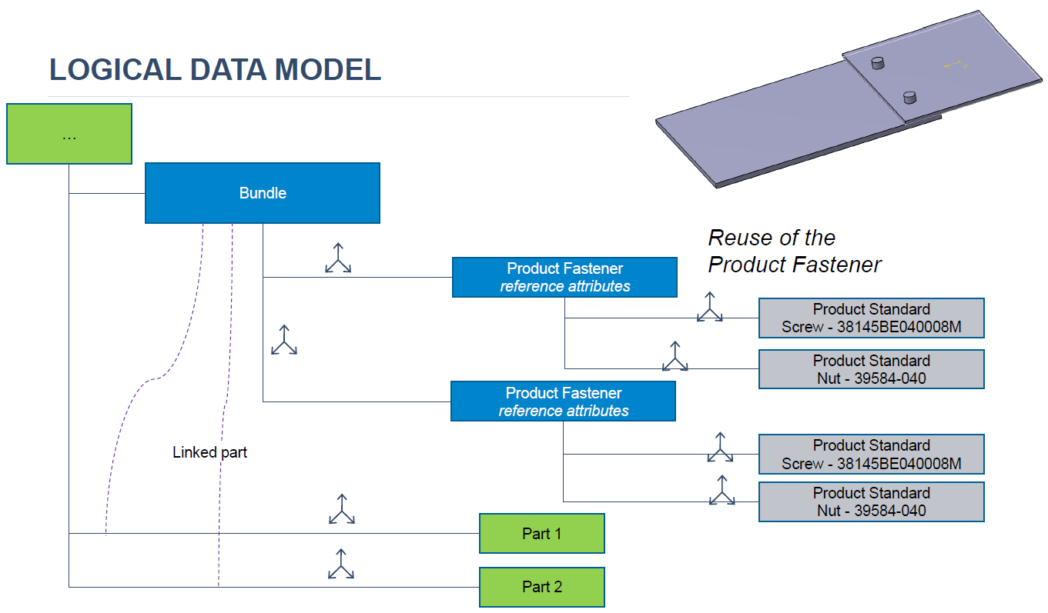
Use Case Status
Fasteners
Full dataset ready for Dassault Aviation Use Case
Assembly Structure mapped from 3DExp->CATIA V5->AP242 XML Edition 3 + P21/JT
Enriched with Bundle definition, references to χMCF file and OccurrenceRelationships between LinkedParts and ProductFasteners (parametric definition of the holes)
χMCF file containing the structure and the reference/instance attributes of the Bundles and the ProductFasteners
Mapping of the attributes to standard attributes or customized attributes
Beta CAE could read this dataset into ANSA
ToDos:
Launch PoC at Dassault Systèmes

Slide 5
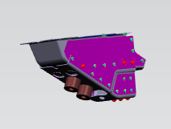
Use Case Status
Fasteners
Full dataset ready for BMW Use Case
χMCF File provided by BMW
containing the structure and the reference/instance attributes of Carrier Sheets and Joining Elements
Many customized attributes seem to contain PDM data
Assembly Structure (stpx) + Geometry (JT)
Enriched with Fasteners and reference to χMCF file
Beta CAE could read this dataset into ANSA
Analysis of the used χmcf custom_attributes
Proposal where to move some of them to AP242 XML file and complete the dataset with combination of AP242 and χMCF
ToDo: on hold since BMW switches from PRISMA to 3DExp

Slide 6
Use Case Status
Fasteners
PRISMA
VIP classic/next
Flat Assemblies
Joining Elements
Computing of Bounding Box according to the s
F1
F2
F3
…
…
T
T
T
T
T
T
T
T
T
P1
P2
P4
P3
Pn
Pm
Carrier Sheet
P3
Pn
Carrier Sheet
P2
P4
Carrier Sheet
P1
Pm
T
Linked Parts
Extraction of the Parts and Joining Elements
CATParts, JTs
JTs
Merging VIP results into Product Structure
minimum use of χmcf custom_attributes
maximum use of AP242 attributes
identical key attributes (label + instance of the parts/joining elements) in both files
AP242 XML file
χmcf file
Ad hoc flat assembly
T
T
T
F1
F3
T
T
T
Pm
F1
F3
P1
P3
Pn
T
Pn
T
Pm
Stacking + mating type
P3
P1
Stacking + reduced custom_attribute list

Slide 7

Issues with DomainModel
7
Multiple MatingDefinitions
rather than multiple MatedPartRelationship chains
Assembly
Part +
PartVersion
Fasteners
Edition 3 used for the PoC with some impediments:
On 3 attributes of the Domain Model, the XSD and schematron rules will be violated:
MatedPartAssociation.MatingType will not be used, but is mandatory
ViewOccurrenceRelationship.Relatand MatedPartAssociation.Related do not support SpecifiedOccurrence (only relevant for DA)
Not even a change of the XSD is necessary, since it can be instantiated
Since the MatingType is mapped to ClassifiedAs, any value is supported (not only the ones defined in MatingTypeEnum, too restricted)
The experience gained by the PDM-IF implementations will contribute to Ed5
Subtype of PartView => not reusable
ViewOf
ViewOf
AssemblyDefinition
Optional => no Todo
Mating Definition
Bundle
Relating
Relating
Relating
Linked Parts
NAOU#1
…
NAOU#n
Relating
Related
MatedPartAssociation
Effectivity#1
Effectivity#n
ClassifiedAs
Relating
Related
MatingType
Mandatory => !?!
MatingType
Stacking
Product Fastener
Mating Materials S[1:?]
MatedPart Relationship
ViewOccurrenceRelationship
Optional => no Todo
Linked Parts
Product Fastener
Instance Attributes
PartView/AssemblyDefinition
Reference Attributes
PartView/AssemblyDefinition
Definition
Drill Diameter
Drill Tolerance
Definition
Related
Definition Based Occurrence
Related
OccurrenceRelationship
Relating
Definition Based Occurrence
Does not support SpecifiedOccurrence => use MatedPartAssociation

Slide 8
DomainModel Proposal for Edition 5
8
Assembly
Part +
PartVersion
TCSC410303-2318
Deprecate MatingDefinition (creates a second assembly structure rather than referencing the design product structure), and does not support multiple Mating Groups on the same AssemblyDefinition (with same InitialContext)
Deprecate MatedPartAssociation and MatedPartRelationship (too limited)
New object MatingGroup for each combination of Linked Parts within the assembly, containing one or many Connections (potentially of different types)
so-called connection_group in χmcf)
MainPart optional to say for example what is the carrying part, or what is the part having all the pins in which the other parts are plugged in
Subtype of AssemblyGroup, group of occurrences, not knowing if/how they are mated together
New object MatingConnection for each type of connection related to a MatingGroup. References one or many occurrences of identical fastener part/assembly
so-called connection_0/1/2d in χmcf
MatingMaterials may be empty for example in case of plugging.
In case of 100 glue points
Use QuantifiedOccurrence once with quantity ‘as needed’
MatingMaterials SET with 100 elements or with 1 element
ViewOf
AssemblyDefinition
UsedIn
AssemblyGroup
Bundle
Members L[1:?] or SET[1:?]
Consider ‘main part’
Relating
Relating
MatingGroup
MatingConnections S[1:?]
NAOU#1
…
NAOU#n
MatingConnection
Product Fastener
Effectivity#1
Effectivity#n
MatingType
Instance Attributes
MatingMaterials S[0:?]
Linked Parts
Product Fastener
PartView/AssemblyDefinition
Reference Attributes
PartView/AssemblyDefinition
Definition
Drill Diameter
Drill Tolerance
Definition
Occurrence
Related
OccurrenceRelationship
Relating
Occurrence
Topic for CAx-IF (hole feature)

Slide 9
Issues with χmcf
Fasteners
https://github.com/economidis-nick/createXSDforxMCF/issues/105 connection_0/1/2d cannot be reused (for example on multiple occurrences)
Has to be defined redundantly within the connection_group
https://github.com/economidis-nick/createXSDforxMCF/issues/95 connection_group.id is not persistent and has to be an integer
Cannot generally overtake the MatingGroup.Id from AP242 (alphanumerical)
3D positioning of the connection_0/1/2d within the connection group is absolute (as if the assembly on which the connection_group is defined was a flat structure)
Requires a conversion from the multilevel CartesianTransformation matrices in AP242 to χmcf location
https://github.com/economidis-nick/createXSDforxMCF/issues/104 connection_0/1/2d ident is unique only within the χmcf file and has to be an integer
Cannot generally overtake the Part.Id from AP242 (alphanumerical)
https://github.com/economidis-nick/createXSDforxMCF/issues/94 Unlike connected_to.part.instance, connection_0/1/2d has no ‘instance’ attribute to identify the SpecifiedOccurrence of each fastener
Misuse of another attribute like ‘label’
https://github.com/economidis-nick/createXSDforxMCF/issues/96
Currently, the hardness and the strength_property_class may be mapped to χmcf for a rivet, but not the material itself. Introducing the material would avoid to map it as custom_attribute.
https://github.com/economidis-nick/createXSDforxMCF/issues/106
New rivet-nut fastener (from Dassault Aviation)

Slide 10
Relevant mating types at BMW
Joining type (name, synonyms, translation) | VERBINDUNGS-ART_ID | VERBINDUNGS-ART_BENENNUNG (for old data from VIP classic: amber) | Type (0d/1d) | Mapping to χmcf 3.1 VDA standard type
HSB / HS / HSS (=Hochgeschwindigkeits-Bolzensetzen / High speed stud ) | 100 | HSB HSS | 0d | <nail>
RP / SP / SCHWPKT (=Schweißpunkt, Widerstandspunktschweißen / Resistance weld spot) | 101 | RP SCHWPKT | 0d | <spotweld> with technology="resistance"
STN / NIET (=Stanzniet, Punching rivet) | 102 | NIET | 0d | <rivet>
NAHT (=Schweißnaht, weld seam) | 103 | NAHT | 1d | <seamweld>
KLEBEN (=Strukturkleben, adhesive) | 104 | KLEBEN | 0d or 1d | <gumdrop> or <adhesive_line>
STUD (=Bolzen / Studs) | 106 | STUD | 0d | <rivet><clinch_rivet_stud>
PLUG / STOPFEN (=Verschlusselement / Closure element) | 107 | PLUG | 0d | <rivet><clinch_rivet_stud>
FLS (=Fließlochschrauben / Flow drill screw) | 108 | FLS | 0d | <threaded_connection><screw>
BN / BLINDNIET (=Blindnieten / Blind rivet) | 109 | BN BLINDNIET | 0d | <rivet>
CL / CLINCHEN / CLINCHPUNKT (=Clinchen / Clinched joint) | 110 | CL CLINCHEN | 0d | <clinch>
RB / SVBA (=Widerstandsbuckelschweißen, Buckelschweißen / Projection welding element) | 111 | RB SVBA | 0d | <spotweld> with technology="resistance"
Joining type (name, synonyms, translation) | VERBINDUNGS-ART_ID | VERBINDUNGS-ART_BENENNUNG (for old data from VIP classic: amber) | Type (0d/1d) | Mapping to χmcf 3.1 VDA standard type
ROV / ROTAV (=Rotation joining element) | 112 | ROV ROTAV | 0d | <rotation_joint><rotav>
CNB (=Clinchnietbolzensetzen / Clinch rivet stud / CRS) | 113 | CNB | 0d | <rivet><clinch_rivet_stud>
RND (=RND-Mutternsetzen / RND nut) | 114 | RND | 0d | <rivet><clinch_rivet_stud>
BNM (=Blindnietmutternsetzen / Blind rivet nut) | 115 | BNM | 0d | <rivet><blind>
SBF (=Stanznietbolzen mit Flansch, SBF-Bolzen(setzen) / SBF stud) | 116 | SBF | 0d | <rivet><clinch_rivet_stud>
VSN (=Vollstanznieten / Full piercing rivet) | 117 | VSN NIET | 0d | <rivet ><solid>
HSN (=Halbhohlstanznieten / Self piercing rivet) | 118 | HSN NIET | 0d | <rivet ><self_piercing>
KSR (=warm structure/seam bonding / warmhärtendes Kleben) | 122 | KSR | 1d | <adhesive_line>
KSC (=cold structure/seam bonding / kalthärtendes Kleben) | 123 | KSC | 1d | <adhesive_line>
KFR (=fold/flange gluing / Bördel-Falzkleben, Kleben Flanschraupe) | 124 | KFR | 1d | <adhesive_line>
Joining type (name, synonyms, translation) | VERBINDUNGS-ART_ID | VERBINDUNGS-ART_BENENNUNG (for old data from VIP classic: amber) | Type (0d/1d) | Mapping to χmcf 3.1 VDA standard type
KVR (=sealent BIW / Versiegelungskleben TKB, Kleben Versiegelungsraupe) | 125 | KVR | 1d | <adhesive_line>
KUR (=antiflutter bead / Unterfütterungskleben Raupe) | 126 | KUR | 1d | <adhesive_line>
KUP (=antiflutter spot / Unterfütterungskleben Punkt) | 127 | KUP | 0d | <gumdrop>
KKR (=adhesive tape / Klebeband) | 128 | KKR | 1d | <adhesive_line>
EDM (=extrudable dumping material / extrudierbares Dämpfungsmaterial) | 129 | EDM | 1d | <adhesive_line>
SG (=gas-shielded welding / SG-Schweißen) | 130 | SG | 1d | <seamweld>, technology="resistance".
SL (=gas-shielded brazing / SG-Löten) | 132 | SL | 1d | <seamweld>, technology="brazing".
LL (=Laser-brazing / Laserlöten) | 133 | LL | 1d | <seamweld>, technology="brazing".
LSR (=Remote laser welding / Remote Laserschweißen) |  | LSR | 1d | <seamweld>, technology="laser".
LST (=tactile laser welding / Taktiles Laserschweißen) |  | LST | 1d | <seamweld>, technology="laser".

Slide 11
Relevant mating types at Dassault Aviation
SCREW-NUT
SCREW-ANCHORNUT
SCREW-ELLIPNUT
SCREW-HELICOIL
SCREW-INSERT
ORD-RIVET
STR-RIVET
BLIND-RIVET
PINS
LOCK
CAPTIVE-SCREW
ERGOTECH
FYBRFAST

Slide 12
Edition 5 example
Mapping from 3DExp to AP242 DomainModel
Part/PartVersion
Assy
AssemblyDefinition
Bundle1
MG1
F1
F1
MC1
F2
F2
MC2
Bundle2
MG2
F3
F3
MC3
LinkedParts
Part1
Part1
Part2
Part2
Part3
Part3

Slide 13
Edition 5 example
Mapping from BMW to AP242 DomainModel
Part/PartVersion
Assy
AssemblyDefinition
Part1
Part1
MG1
JE1
JE1
MC1
JE2
MG2
JE2
MC2
Part3
LinkedParts
Part3
MG3
JE3
JE3
MC3
JE3
JE3
MG4
MC4
Part2
Part2

Slide 14
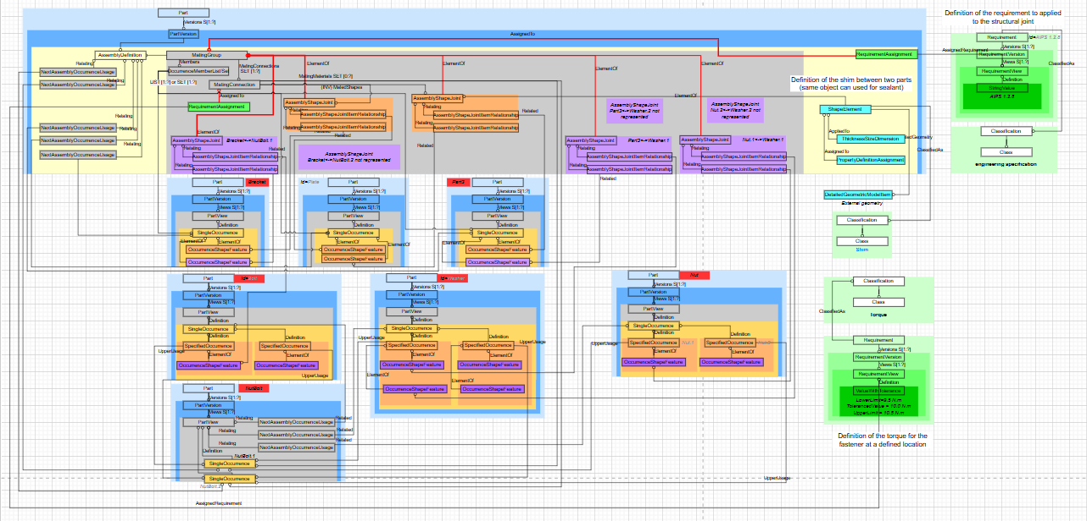
Edition 5 example
Use of AssemblyShapeJoint
Pierre 27.3.25: MatingConnection shall group only different occurrences of identical fasteners for which ALL the parameters/requirements/… are the same => RequirementAssignment shall always reference MatingGroup (even if there is only one occurrence of a fastener within a MatingConnection) => PartInformationSelect shall include also AssemblyGroup (for AssemblyShapeJoint.ElementOf

